Slide 1

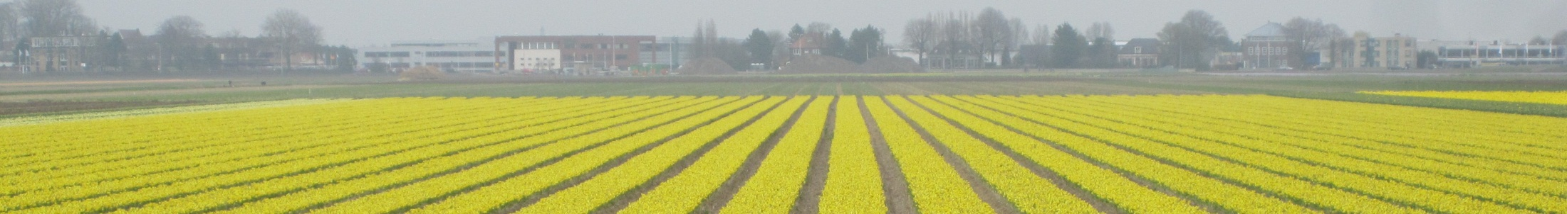

Dan Bolser, EMBL-EBI
trans-National Infrastructure for Plant Genomic Science
Triticeae data in Ensembl Plants Versailles, 12th-13th November 2012

Slide 2
Introduction

Slide 3
Triticeae crops
Wheat
Barley
Bread wheat (Triticum aestivum) accounts for 20% of human consumption of calories and protein.
Hexaploid (AA/BB/DD)
7 chromosomes
17Gb genome
~80% repeats
Currently only a fragmented assembly is available.
Barley (Hordeum vulgare) an important cereal and model for ecological adaption.
Diploid
7 chromosomes
5.3Gb Genome
~80% repeats
Integrated gene-space and physical map.

Slide 4

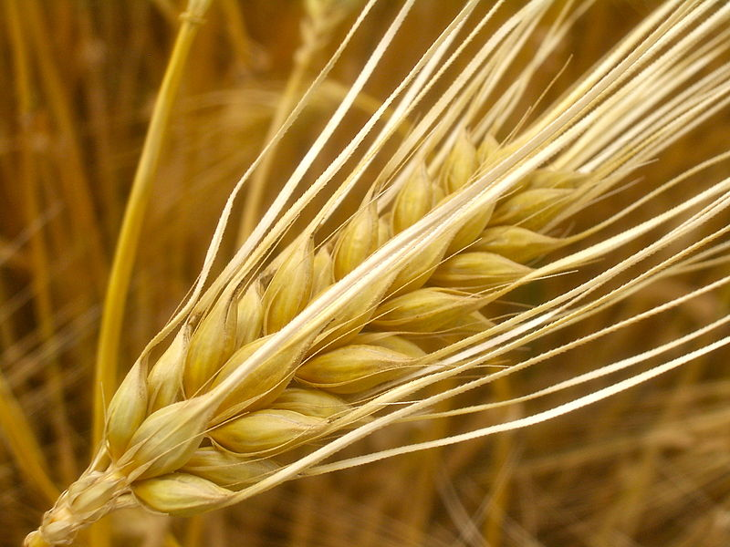
Triticeae crops
Wheat
Barley

Slide 5
Wheat

Slide 6
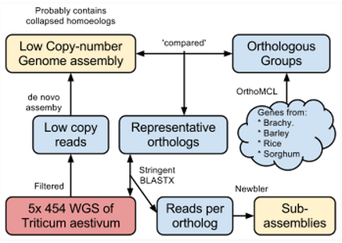
Wheat – Sequence data
Gene-space ‘sub-assemblies’
1,394,281 sub-assemblies
contigs and singletons
Data provided:
“in the syntenic context of Brachypodium distachyon”
117,411 (89%) mapped

Slide 7
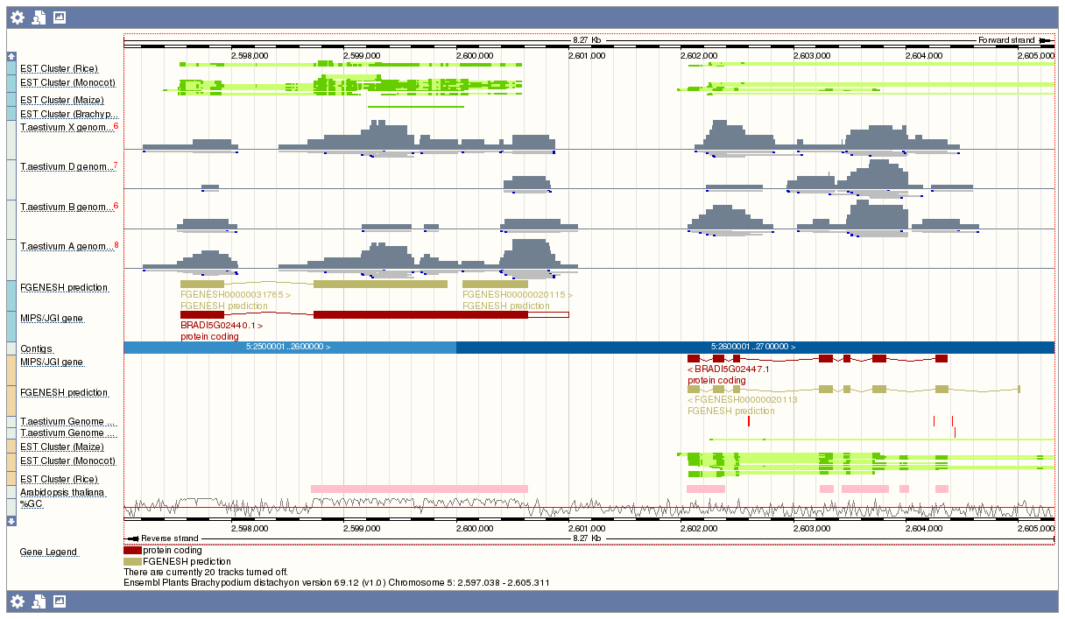
Wheat
Wheat sub-assemblies, classified into A, B, D (and X) genomes, aligned to Brachypodium distachyon in Ensembl Genomes

Slide 8
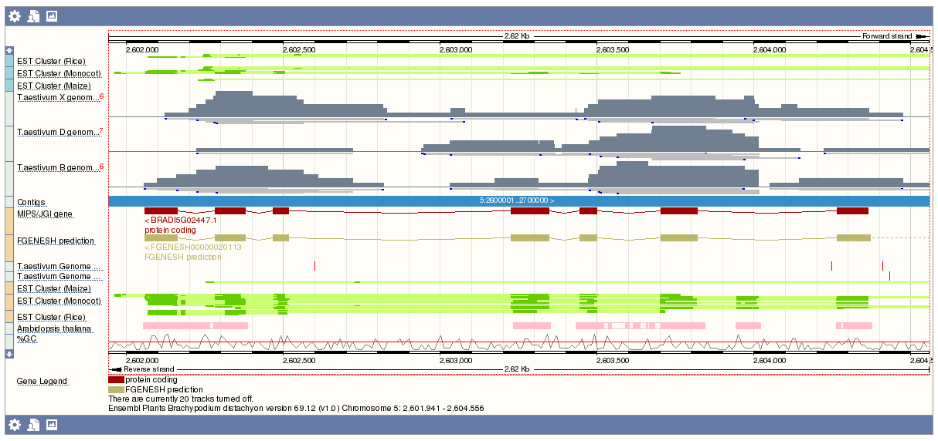
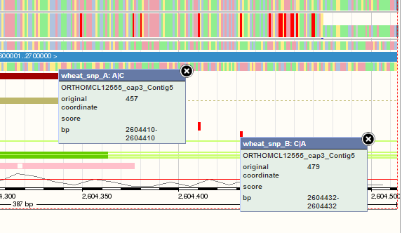
Wheat sub-assemblies and homoeologous SNPs
Wheat sub-assemblies, classified into A, B, D (and X) genomes, aligned to Brachypodium distachyon in Ensembl Genomes, showing homoeologous SNPs (variations between the A, B and D genomes).

Slide 9
Barley

Slide 10
Barley NOTES
Gene-space assembly
Integrated physical map
View of chromosomes and genes in EG
All the ‘features’ of Ensembl,
Trees,
Functional annotation

Slide 11
Barley – Sequence data
cv. Morex
5x Illumina GAII
300b PE
2.5kb PE
376k contigs > 1kb
100k directly integrated into PM
+ a hierarchical approach for other sequence data

Slide 12
Barley – Gene & physical map data
Gene calls
Genes
167Gb of RNA-Seq
29k fl-cDNAs
79k 'transcript clusters'
26k 'High Confidence' genes (by homology)
95% anchored on WGS contigs
Physical map data
Fingerprinted BACs
600k BACs (14x) in six different BAC libraries
10k FPC contigs with estimated n50 of 900kb
500k x2 BES, 6k WGS
Markers
3000 gene-based
500k sequence tags

Slide 13
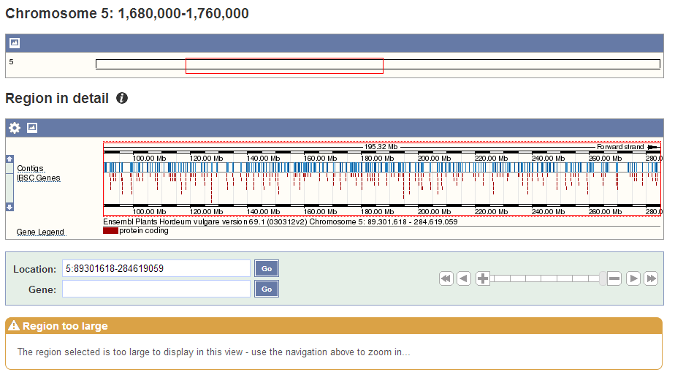

Slide 14
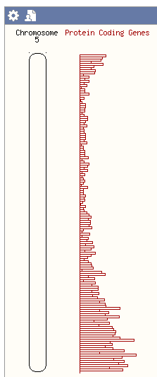

Slide 15
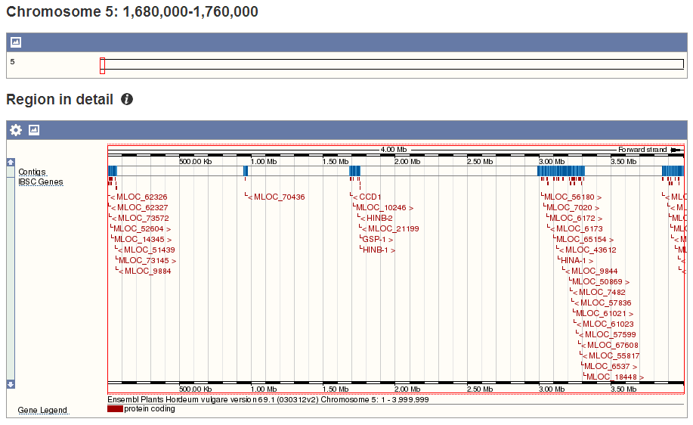

Slide 16
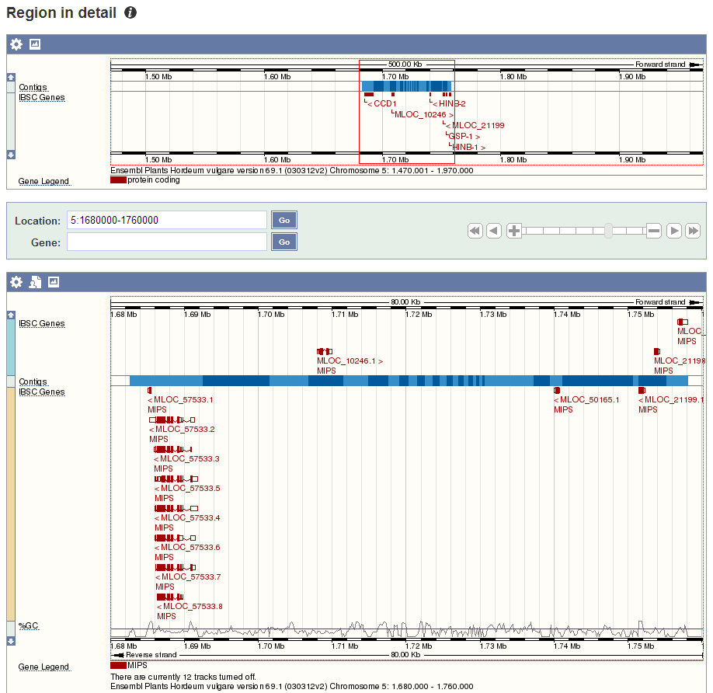

Slide 17
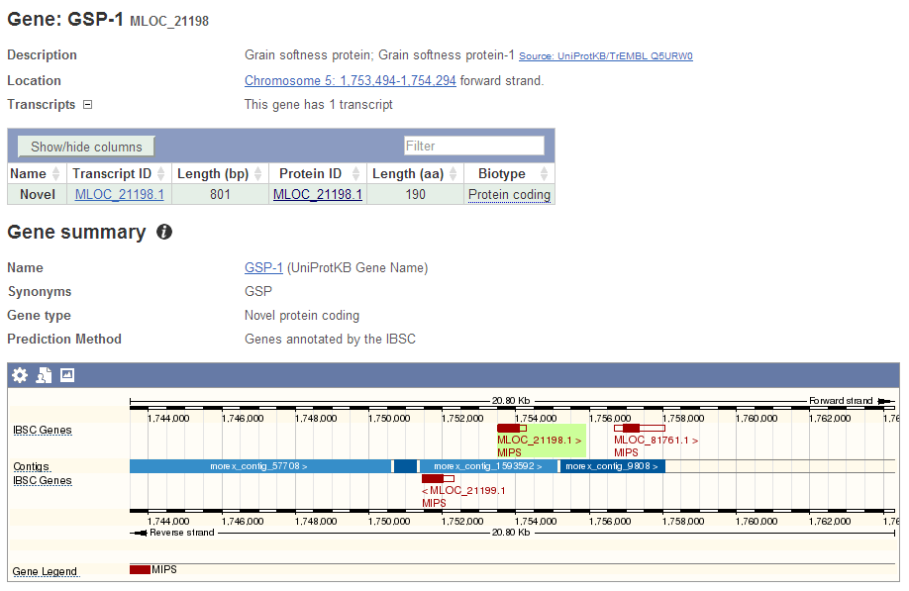

Slide 18
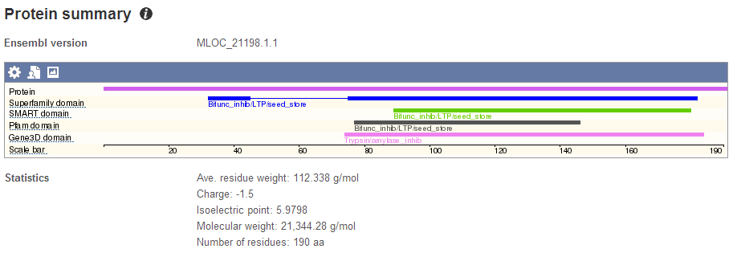
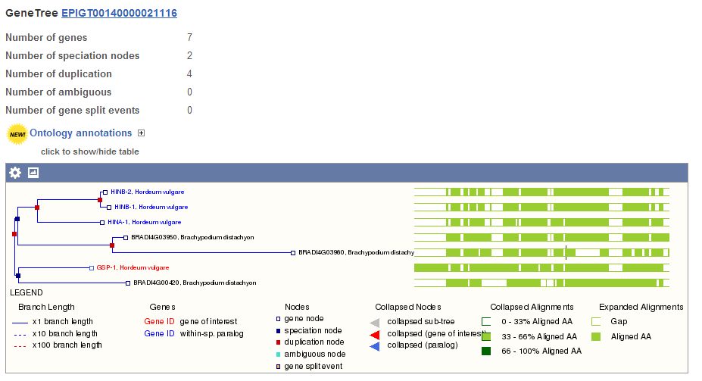

Slide 20
Summary

Slide 21
Wheat
Too fragmented for a genomic assembly
Shown in the syntenic context of Brachypodium distachyon
Small, model grass
Diploid
270 Mbp
Relatively low repeat density
Sub-assemblies classified into homoeologous chromosomes
Homoeologous SNPs (SNPs between A, B, and D genomes) mapped onto brachypodium.

Slide 22
Barley
26,000 high confidence genes called
More than 90% anchored into a chromosome-scale physical map
Standard Ensembl Genomes analysis pipelines can be run
Comparative genomics
Functional annotation
InterProScan

Slide 23
Acknowledgements

Slide 24
Questions?

Slide 25
Alignment stats for wheat sub-assemblies on brachypodium
 | Sub-Assemblies (88% singletons) | Aligned to brachy. | Full length alignment?
A | 123,383 (13%) | 115,804 (94%) | 114,375 (99%)
B | 158,440 (17%) | 141,278 (89%) | 138,438 (98%)
D | 156,976 (17%) | 144,810 (92%) | 142,635 (98%)
X | 510,480 (54%) | 412,385 (81%) | 402,049 (97%)
Total | 949,279 | 814,277 (86%) | 797,497 (98%)

